Slide 1
CENTRE for INDUSTRY
EDUCATION COLLABORATION
Sustainable fuel:
Electricity to gas

Slide 2

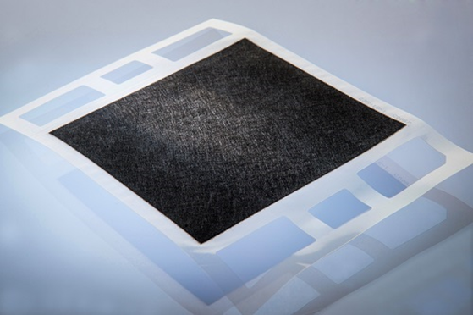
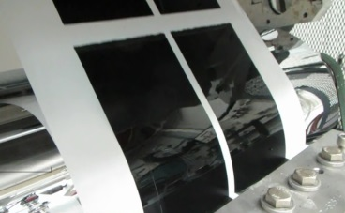
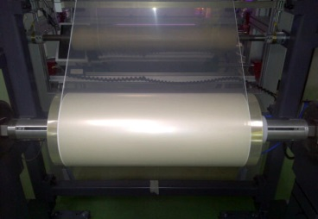
Scientists and engineers work together to design, test and make fuel cells and their components.
fuel cells
computer design of fuel cell
fuel cells being made in a factory

Slide 3
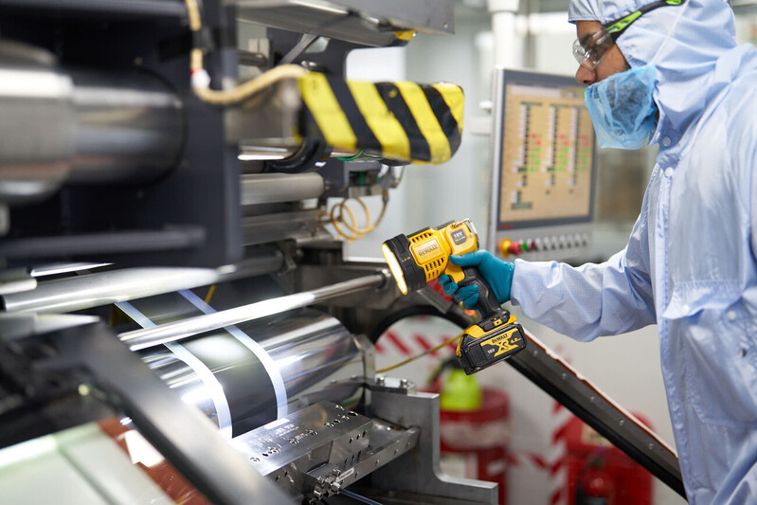
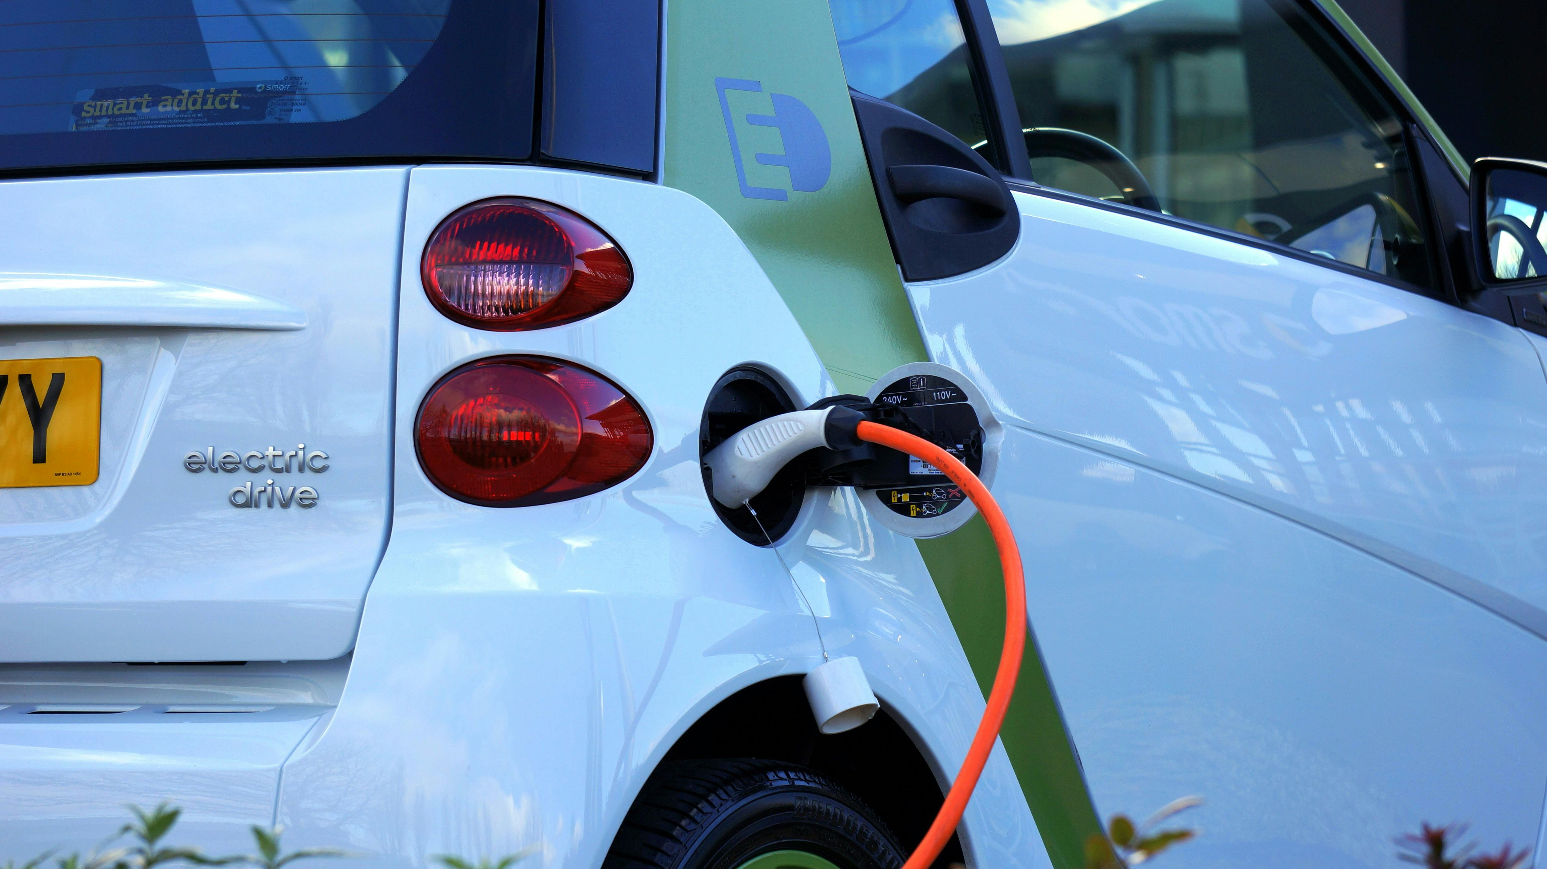
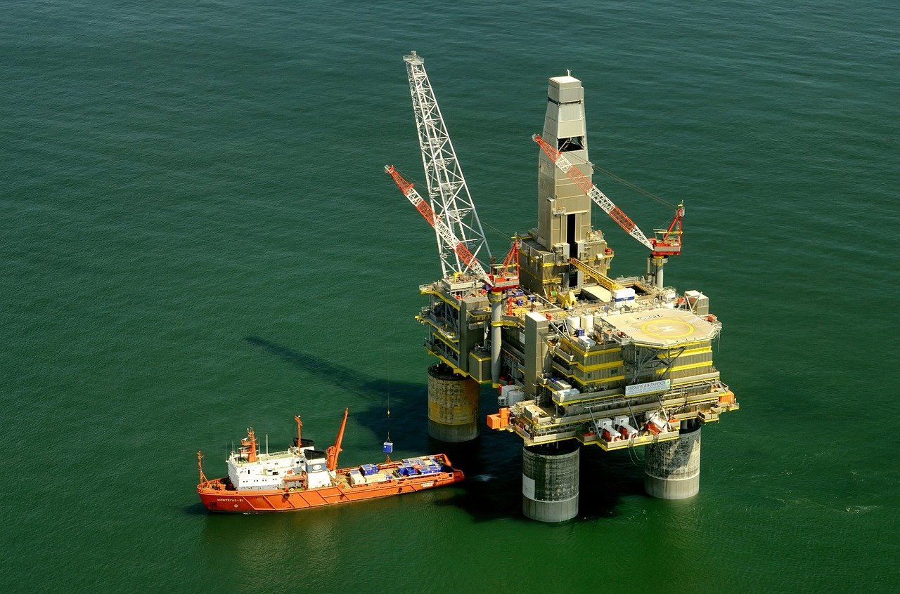
Scientists and engineers design, test and build fuel cells which carry out the reverse process of getting hydrogen gas (bubbles) using electricity.
Fuel cells use hydrogen gas to produce electricity for electric vehicles. Fuel cells which use hydrogen from sustainable sources are better for the environment than petrol and diesel.
The electricity generated from these fuel cells is cleaner than using crude oil (petrol and diesel come from this), natural gas, or coal.

Slide 4
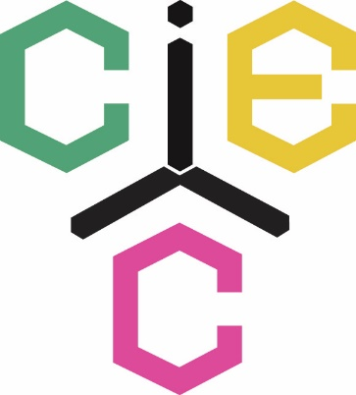
www.ciec.org.uk

